Slide 1
Hotel Booking Analysis
Booking Patterns and Key Operations Analysis
Prepared by: Mihir Hattangdi
Date: August 23, 2024

Slide 2
Introduction
Objective:
Analyze hotel booking patterns and trends.
Provide actionable insights and recommendations for optimization.
Agenda:
Peak Booking Seasons
Cancellation Patterns – Seasonal Trends and Influences
Customer Segmentation -- Customer Types , Booking Patterns Segmentations
Revenue Optimization
Marketing Channels
Special Requests Service – Service and Relation with ADR
Lead Time and Repeated Guests

Slide 3
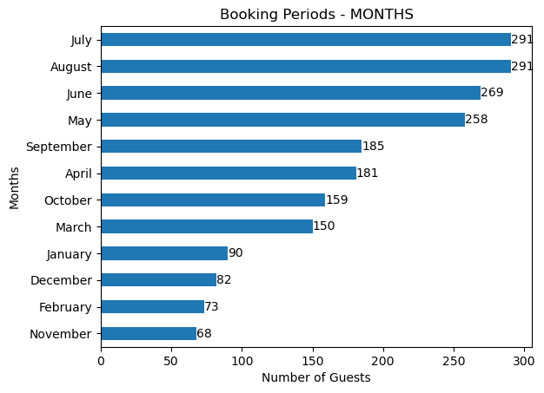
Peak Booking Seasons
Highest number of bookings in July and August.
Focus marketing and promotions during these months to maximize occupancy and revenue.

Slide 4
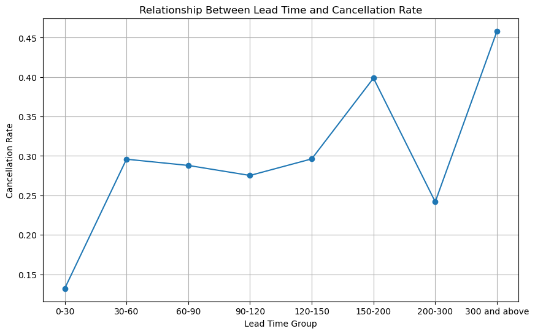
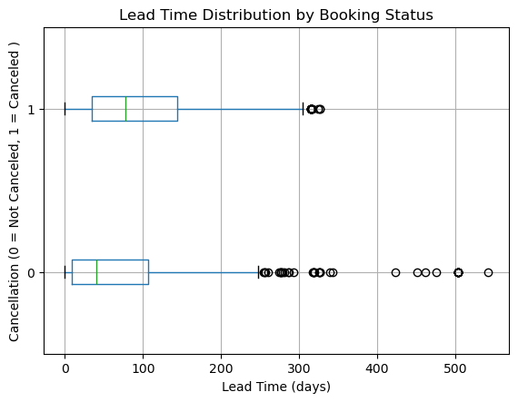
Cancellation Patterns
Higher cancellation likelihood when lead times exceed 300 days or fall between 150-200 days.
Implement strategies such as flexible booking options or incentives for early commitment to mitigate cancellations.

Slide 5
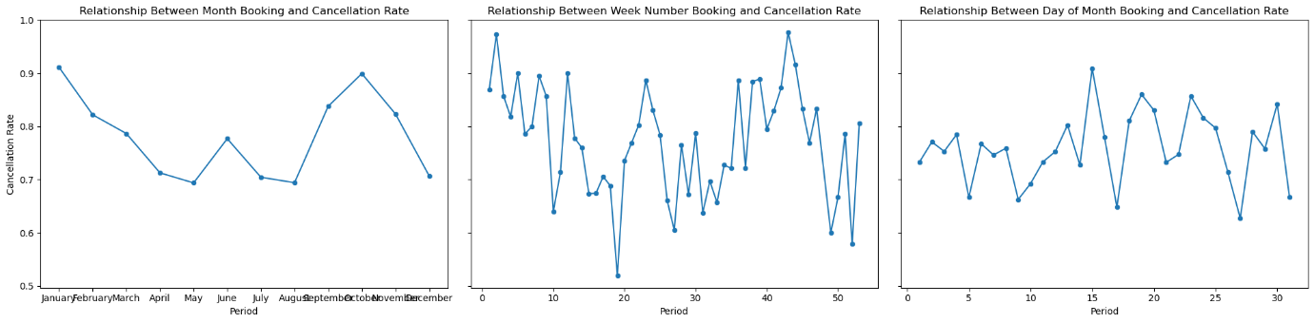
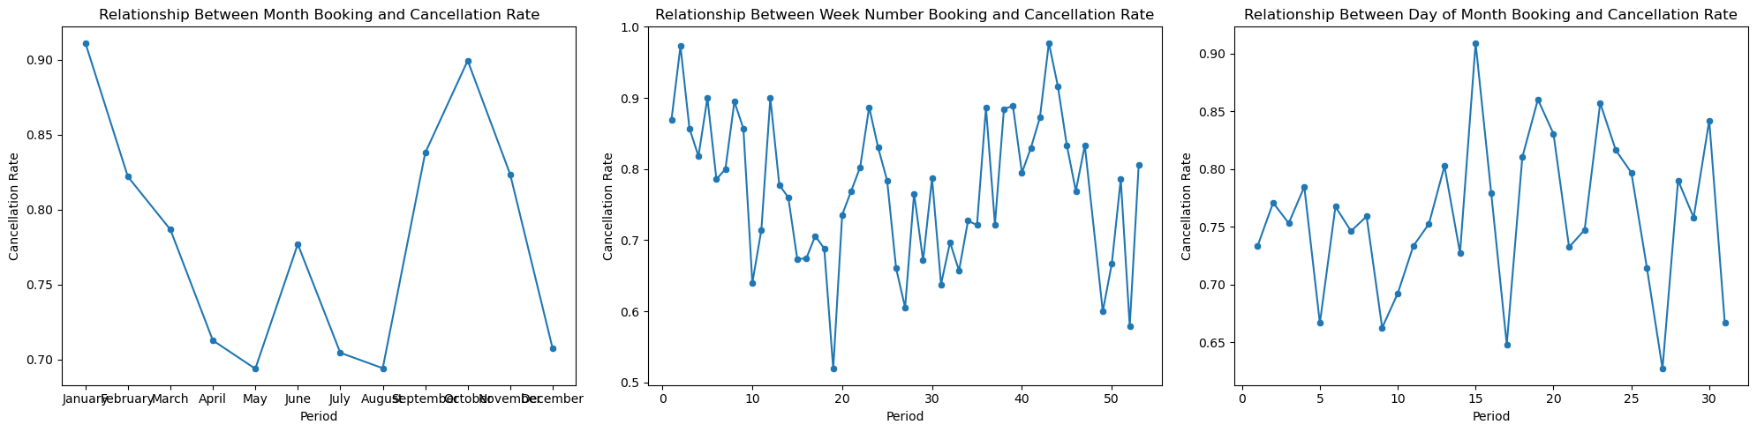
Seasonal Cancellation Trends
Higher cancellation rates in February and October.
Decrease in cancellations during the first 30 weeks with an increase towards week 40.
Monitor and address factors leading to cancellations during these periods.

Slide 6

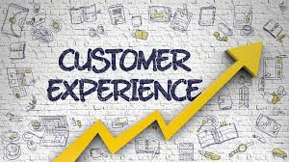

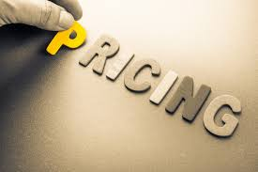
Cancellation Influencers
Factors such as lead time, pricing, weather, alternative options, and customer experience influence cancellations.
Tailor strategies to manage these factors and reduce cancellation rates.

Slide 7
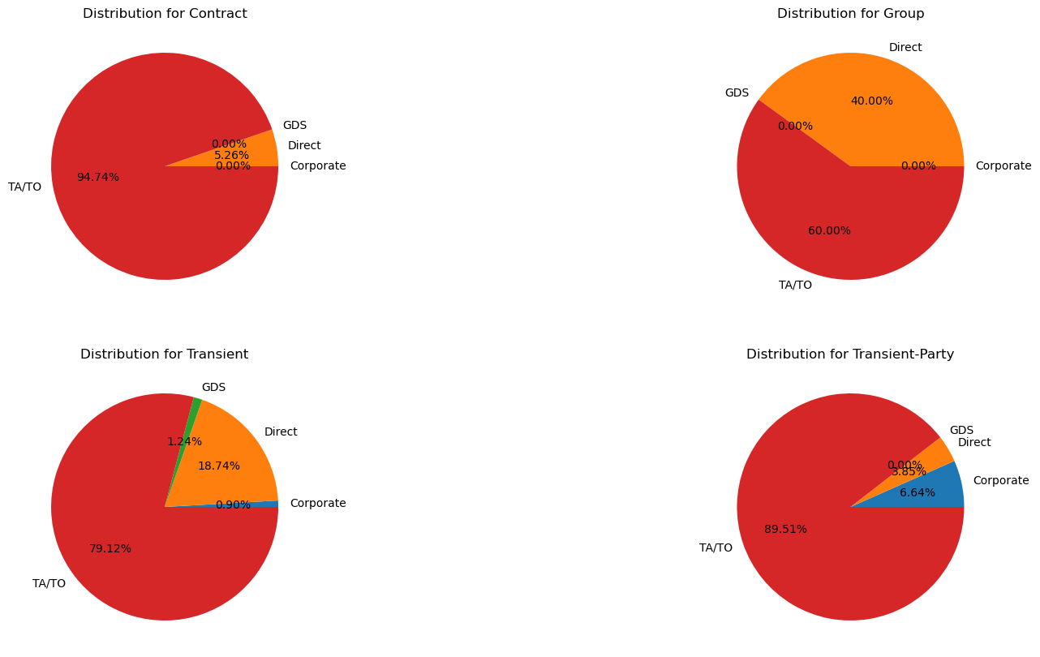
Customer Types and Booking Patterns
High reliance on travel agents and operators across all customer types (Contract, Group, Transient, Transient-Party).
Strengthen relationships with travel agents and operators to drive bookings.

Slide 8
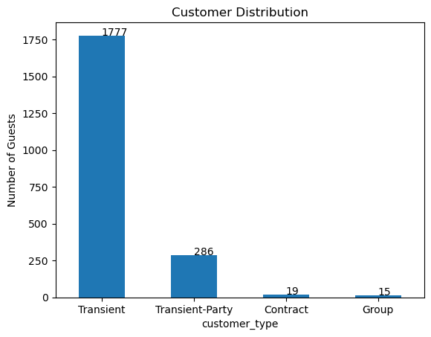
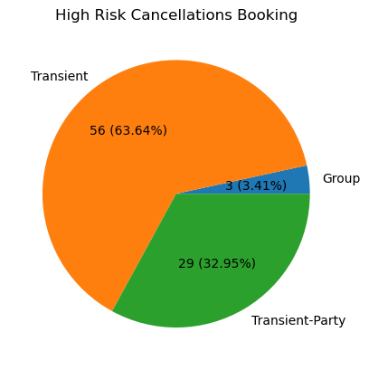
Customer Segmentation
Segmentation of customers based on booking and cancellation risk.
Offer targeted incentives and personalized services based on customer type and booking behavior.

Slide 9
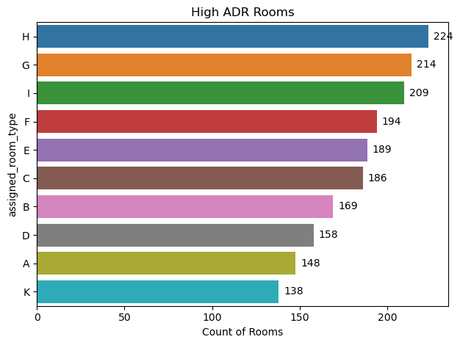
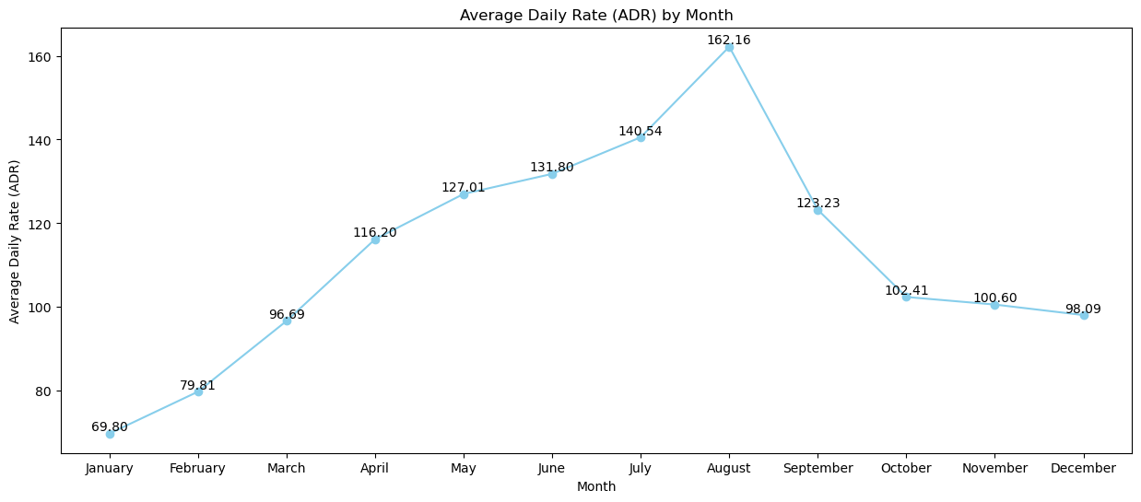
Revenue Optimization
Rooms H and G have higher Average Daily Rates (ADR).
Peak earning months in July and Augusts
Focus pricing strategies on high ADR rooms and peak periods.

Slide 10
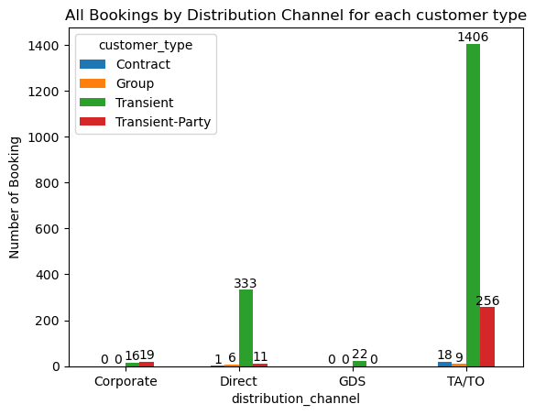
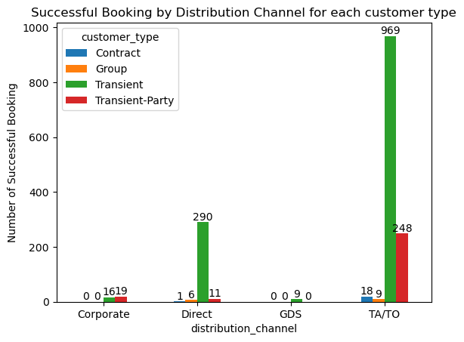
Marketing Channels
Travel agents and tour operators are the most effective channels.
Leverage these channels for targeted marketing efforts.

Slide 11
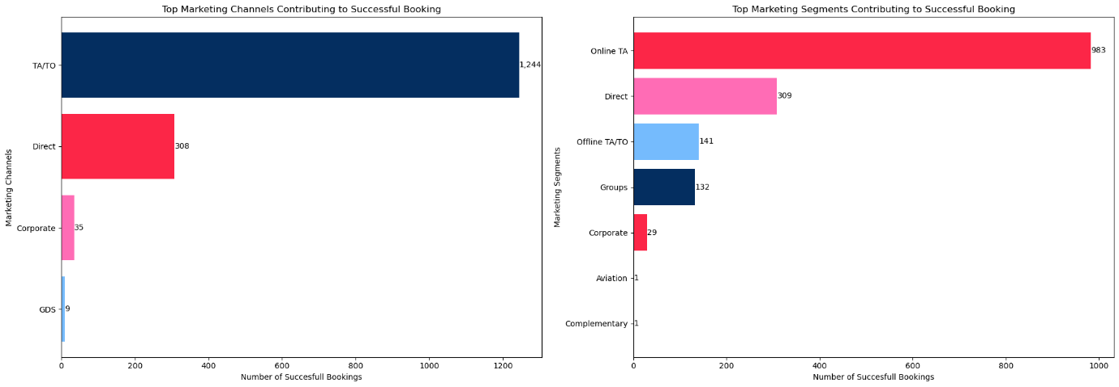
Marketing Channels
Travel agents and tour operators are the most effective channels.
Leverage these channels for targeted marketing efforts.

Slide 12
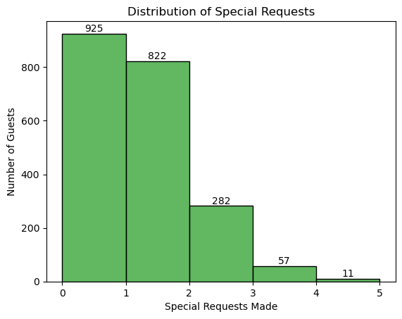
Guest Special Requests Service
Limited special requests indicate opportunities to create bundled packages and offers.
Develop packages that encourage guests to request additional services.

Slide 13
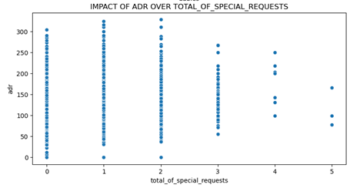
ADR and Special Requests
Higher ADR (at least 2 requests) is associated with more special requests.
Encourage special requests through premium pricing strategies.

Slide 14
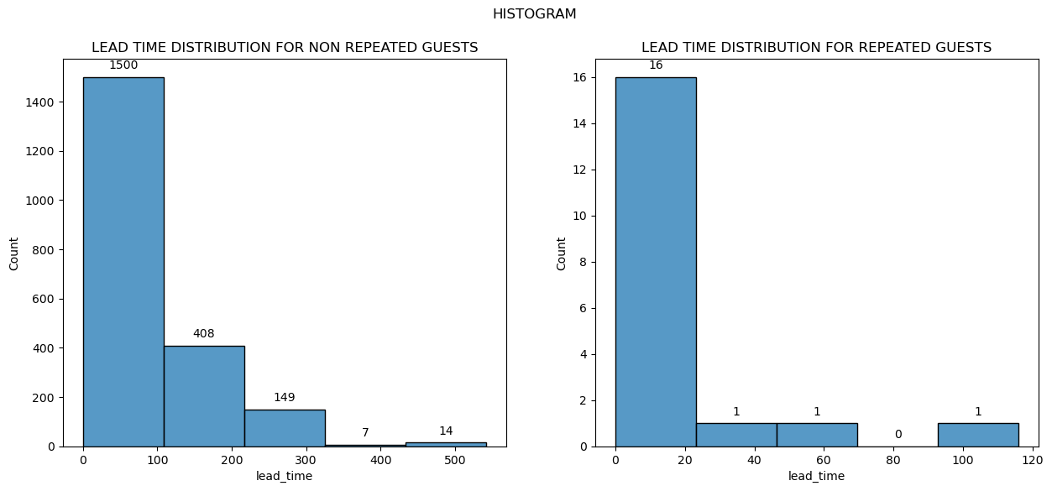
Lead Time and Repeated Guests
Repeated Guests Often have a closer lead time as compared to that of Non- Repeated Guests.
Tailor Offers and Create Loyalty Programs may also create last minute deals to attract Guests and fill vacancies

Slide 15
Recommendations
Targeted Marketing: Focus on corporate and group customers.
Special Offers: Provide attractive offers during peak booking seasons.
Cancellation Reduction: Improve customer experience and offer incentives.
Revenue Optimization: Leverage peak periods and high ADR rooms.
Customer Loyalty: Implement loyalty programs and personalized services.
Channel Collaboration: Strengthen partnerships with travel agents and operators.

Slide 16
Conclusion
Next Steps:
  Develop detailed action plans for marketing and customer engagement.
  Set up monitoring systems to track the effectiveness of implemented strategies.
  Continuously gather and analyze data for ongoing improvement.

Slide 17
Thank You!
Contact Information:
Email: mihirvh@gmail.com
Phone: +91 7506337172

